Slide 1



LinkedIn for
Sixth Formers
How to kick start your
career online
INSERT NAME
INSERT JOB TITLE
INSERT COMPANY
Enterprise Adviser, INSERT SCHOOL
Notes:
This workshop is designed for students aged 16+. LinkedIn’s user agreement states that the minimum age for people using it is 16 https://www.linkedin.com/legal/user-agreement
Schools: Presenters will need internet access to demonstrate LinkedIn to students. This workshop has be designed in two parts, but feel free to change it to suit your timetable. The first part introduces LinkedIn and discusses what it is, and the presenter can deliver this online remotely or in person to a class. The second part is a practical session and gets students to set up their own account on LinkedIn, so individuals need access to a computer.
Presenters: Please add your own company logo to the title side, and introduce yourself, your connection to the school and the company you work for. This then becomes a really well-rounded Gatsby Benchmark 5 employer encounter activity.

Slide 2

Content
Session 1: What is LinkedIn? (theory)
It’s not just for old people with briefcases
About LinkedIn: professional not personal
LinkedIn: what’s in it for you?
Start early
Why do employers use LinkedIn?
Introducing…
Any questions?
Session 2: Setting up LinkedIn (practical)
What are you waiting for? Go. Find.
Be found.
Step 1: Set up your account
Step 2: Create your profile
Step 3: Link with connections
Step 4: Share content
Feedback

Slide 3
Session 1
What is LinkedIn?

Slide 4

“It’s not just for old people with briefcases…”
Notes:
Play short video (1 min 34 sec): Start your career - LinkedIn for Students
Click on the link in slide show mode.

Slide 5

About LinkedIn
World’s largest professional social networking site.
Began in co-founder Reid Hoffman’s living room 2002, officially launched May 2003.
Bought by Microsoft in 2016.
700+ million members in >200 countries.
2 new members join LinkedIn each second.
Mission: “to connect the world’s
professionals to make them more
productive and successful”.
Notes:
Ask students ‘Who’s heard of LinkedIn?’ and get answers to make the session interactive.

Slide 6




It’s professional… not personal

Slide 7






Eating donuts on your
personal social media
Check out my donut filter
Here’s a donut recipe
Anyone want
a donut?
I like donuts
Here’s a cool picture of a donut
I’m listening to “Donuts”

Slide 8

Eating donuts on LinkedIn
I hope to operate a donut franchise one day
I have three years’ experience of making donuts
Here are 3 recommendations from former donut colleagues
I’m looking for a job at a donut company
My top skills are donut production and sales

Slide 9

LinkedIn: what’s in it for you?
Miss it, miss out: businesses use LinkedIn to promote job vacancies and recruit new talent.
Clear the first hurdle: almost all recruiters use it to screen out applicants.
‘Your cv that never sleeps’: advertise your experience, skills and education and communicate your unique personal brand round the clock.
You snooze, you lose: hear the latest news, opportunities and events from the business world.

Slide 10

LinkedIn: what’s in it for you?
Get insider info: use it to research companies before interview.
It’s free! (There is a paid-for premium version, but the free version has everything you’ll need.)

Slide 11

Start early
LinkedIn is for anyone looking
to advance their career – including
students taking their first step.
Minimum age is 16 years.
Even at this early stage, you have plenty to shout about.
It’s your opportunity to meet your future boss.
Notes:
Extra context for presenter to talk around:
Many people assume you can only join LinkedIN AFTER you’ve left school or college when you’ve already got on the first rung of the careers ladder – but there are definite benefits to creating a strong LinkedIn profile sooner rather than later. Here’s why:
1. Stand out from the school competition
Only 1 in 10 school students use LinkedIn, so those who do have a better chance of standing out from their peers.
2. Set yourself up for career success
Taking the time to craft a LinkedIn profile tells a potential boss that you’re serious about your future in the work force. Also, if you’re looking for a work experience or a part-time job, start your research here. Don’t wait for opportunities to come to you: connect and then DM individuals or companies and tell them you’re interested in finding out more. It’s easy to search for specific companies or sectors you’re interested in.
3. Create (and control) your unique personal brand
You often hear “Don’t post anything you wouldn’t want your headteacher to see!” - but LinkedIn gives students the opportunity to post your skills and achievements and create an image you’re proud of and want potential employers to find.
4. Start professional networking early
LinkedIn is your little black book. Had a good work experience placement? Connect with your new contacts on LinkedIn. When you leave school and become an alumnus, connect with your school and make it easy for them to stay in touch and follow your progress. Had a part time job? Log it and link to the company – and if you created a good impression, ask them for a recommendation or to endorse your skills.

Slide 12

Tell your future boss:
What you are currently studying
Your goals and aspirations: the role or industry you’d like to work in
Skills you’ve developed (through school, volunteering, extra-curricular
activities or clubs)
Positions of responsibility (eg sports team captain, school
council, prefect)
Work experience placements, part-time student jobs
and volunteering roles
Existing qualifications (eg GCSEs, first aid, EPQ)
Personal achievements (eg music exams, sports challenges)
Notes:
NOTE: EPQ = extended project qualification. More here https://www.aqa.org.uk/programmes/aqa-baccalaureate/extended-project/the-aqa-epq

Slide 13

Why do employers use LinkedIn?
To grow their business by generating new sales leads
To build their reputation and brand awareness
To establish themselves as industry influencers
To work collaboratively and develop new partners
To vet candidates applying for positions
To proactively research new talent and promote new vacancies to their chosen target audience

Slide 14
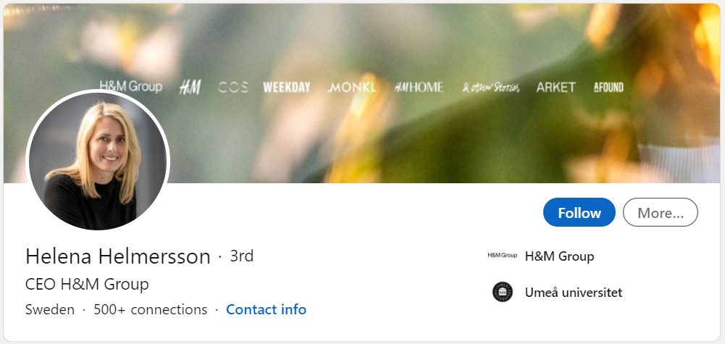
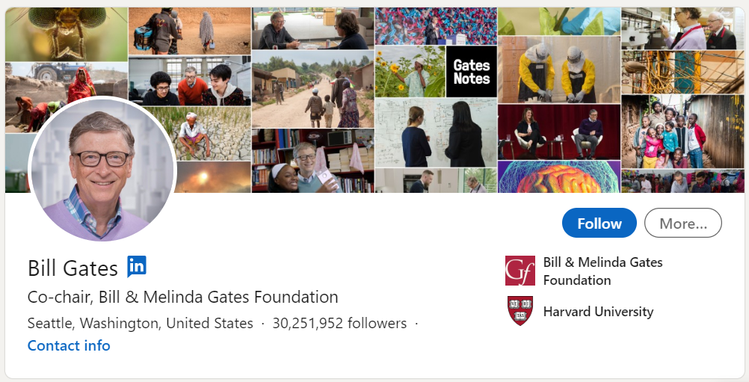
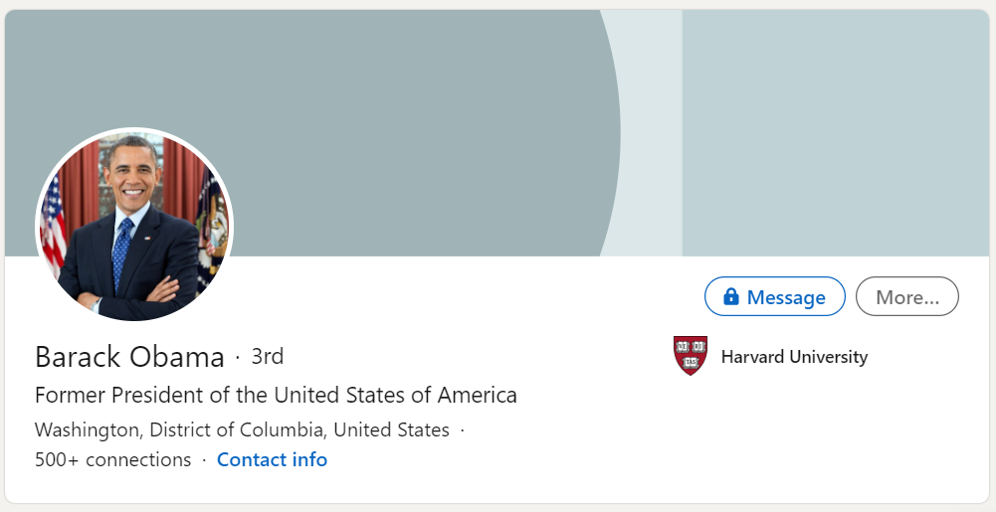
Introducing…
Notes:
Click through briefly to each of these high profile people who have a LinkedIn profile:
Helena Helmersson, CEO of H&M Group (a fashion chain students will hopefully have heard of!) https://www.linkedin.com/in/helenahelmersson/
Bill Gates, co-founder of Microsoft and now Co-Chair of the Bill & Melinda Gates Foundation https://www.linkedin.com/in/williamhgates/
Barack Obama – needs no introduction https://www.linkedin.com/in/barackobama/

Slide 15
Sharing my own profile
Notes:
Presenters: please add a screenshot of your own LinkedIn profile and add a link through to it. Talk students through your own profile, highlighting career pathway, skills etc.

Slide 16

Time for a break – and a donut?
In our next session, we’ll look at how to set up LinkedIn.
Until then, any questions?
With thanks to Matthew Weatherby, Social Value Manager at Willmott Dixon, for
his input and Brian Phillips at LinkedIn.
Notes:
If there’s time at the end of the lesson, students can explore LinkedIn for themselves, if they have mobiles/laptops in lesson.

Slide 17
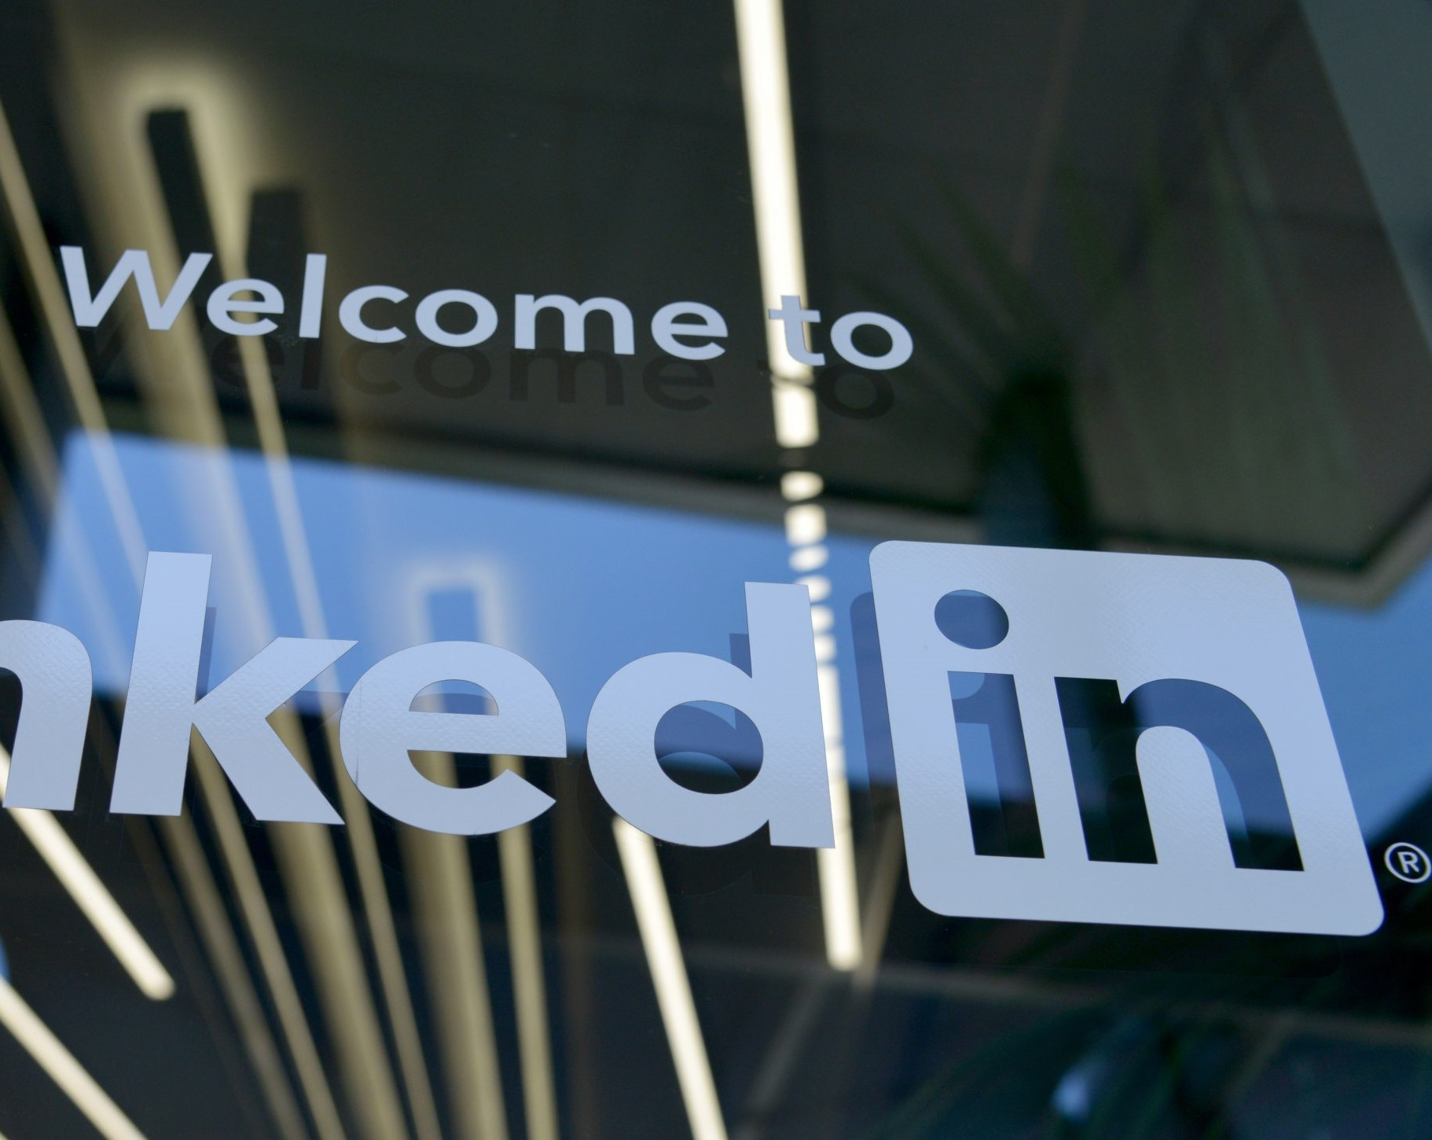
Session 2
Session 2
Setting up LinkedIn
Notes:
This is a practical session: the aim is that sixth formers will have access to a computer and set up their profile during the workshop. The presenter could be in the room or provide virtual guidance to students in the classroom.

Slide 18
Content
Session 2: Setting up LinkedIn (practical)
What are you waiting for? Go. Find. Be found.
Step 1: Set up your account
Step 2: Create your profile
Step 3: Link with connections
Step 4: Share content
Feedback

Slide 19

“What are you waiting for?
Go. Find.
Be Found.”
Notes:
So how do you get started with LinkedIn? It’s really not complicated, and as digital natives, young people are already well ahead of the game! Just remember: nothing too personal, nothing too clever.
Play short video (1 min 21 sec): Top Five Profile To-Do’s - LinkedIn for Students
Click on the link in slide show mode.

Slide 20
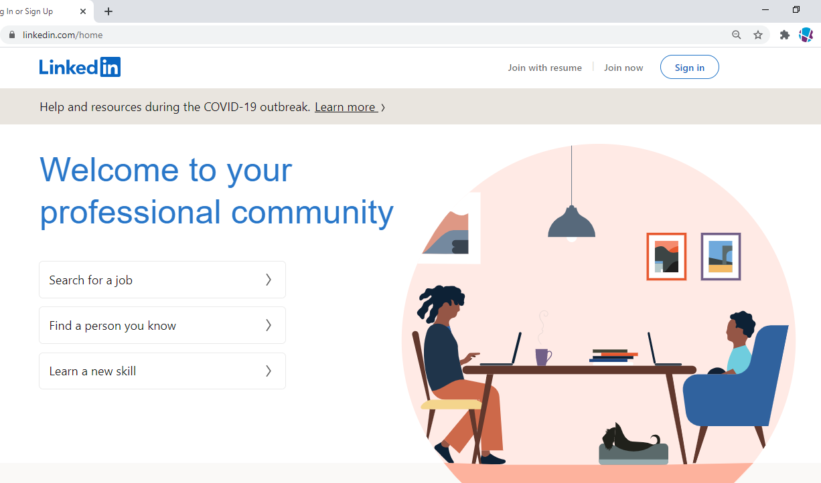
Step 1: Set up your account
Visit www.LinkedIn.com
and click ‘Join now’.

Slide 21
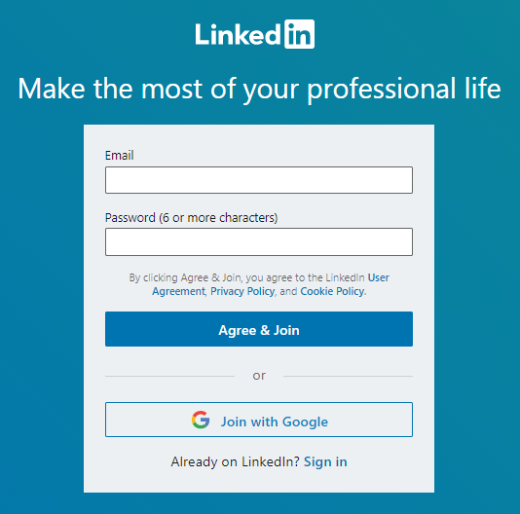
Setting up your account continued…
Add your school or another professional-sounding email (not ‘sarahluvscats@gmail.com and don’t include your date of birth!) plus a password to create your account.
Do the quick security check to verify you’re not a robot!
On the next page, get started by entering your county, post code and location.

Slide 22
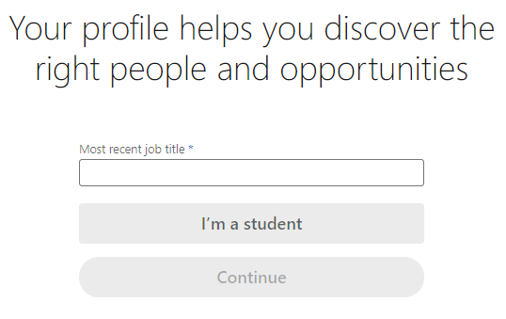
Setting up your account continued…
On the next page, instead of adding ‘Most recent job title’, click on ‘I’m a student’. This treats you like you are university student, but don’t worry, we can round that.

Slide 23
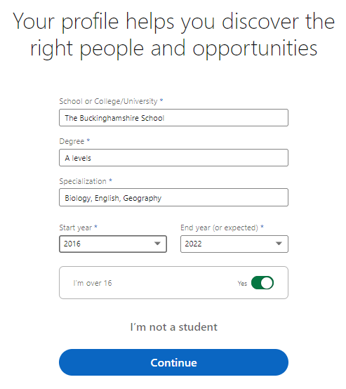
Setting up your account continued…
On the next page, add your school (if your school has a LinkedIn page select this or input it as a new entry).
Where it ask for degree, insert ‘A-Levels’.
In the ‘Specialization’ box, write the subjects you are studying).
Finally, add in your sixth form school start year (Year 12) and end year (Year 13) and click continue.

Slide 24
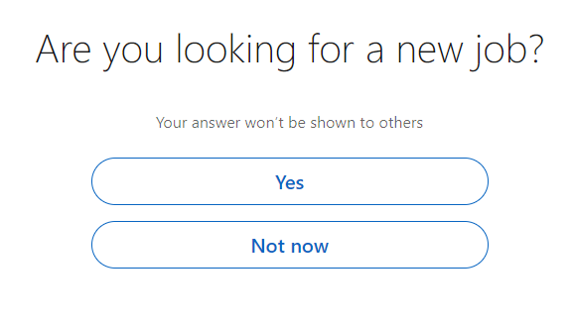
Setting up your account: almost done!
Check your email and you’ll find a pin code from LinkedIn: either enter the code when asked or click on ‘agree and confirm your email’ to complete sign up.
When it askes you ‘Are you looking for a new job?’, just put ‘No’ and then skip all the way to the ‘Finish’ button (so skip importing your email contacts, skip connecting with people, skip the photo etc for now) which takes you to the main landing screen.
This will create your account. Don’t worry, you can change everything shortly and keep adding to it over time. But for now, well done: we’ve achieved step 1.

Slide 25
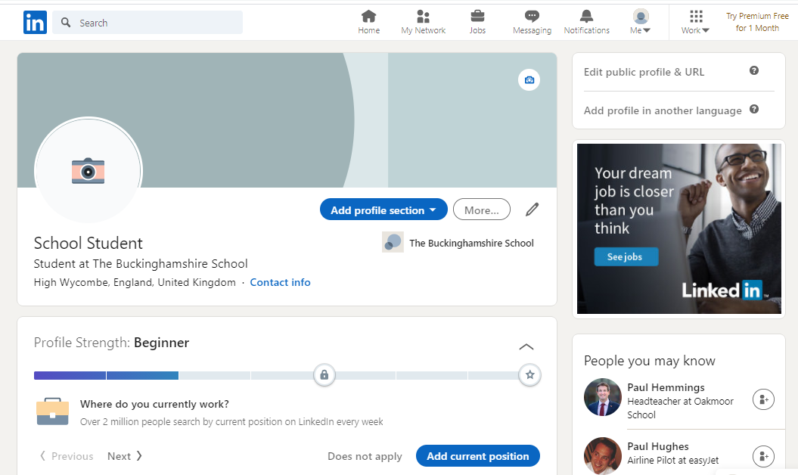
Step 2: Create your profile
You should now see a landing page that looks a bit like this.
We need to take your profile strength from beginner to all-star.

Slide 26
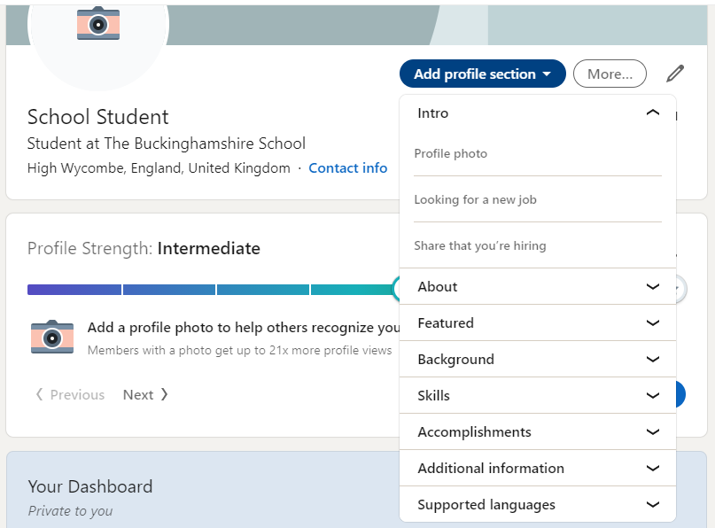
Build your profile strength
Your profile strength just means the depth of information you’re providing. The more engaging, meaningful the details, the more people will want to find out more about you.
We’ll now look at each profile section in turn to take you from beginner to intermediate and finally to all star – so you really stand out from the crowd.
Click on ‘Add profile section’ circled here to navigate your way through.

Slide 27
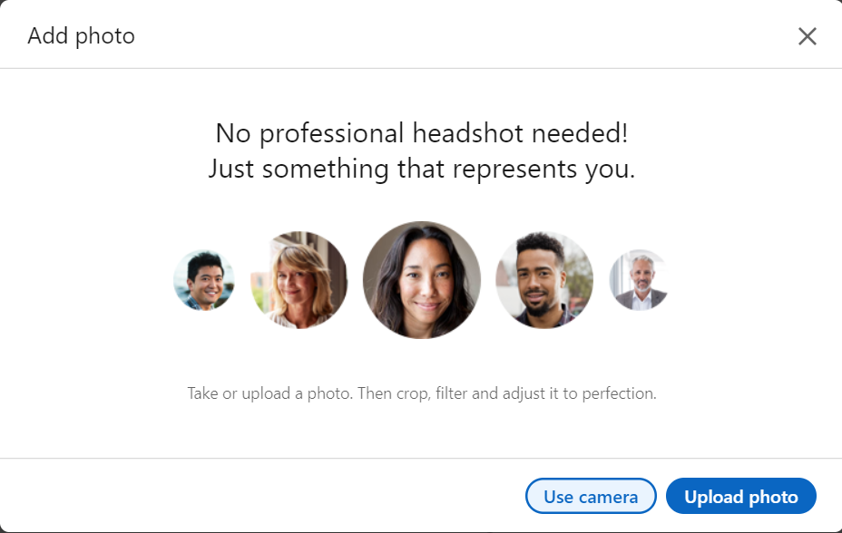
Build your profile strength: ‘Intro’
In the Intro, we’re going to add a photo to your profile – so you’re 21x more likely to be viewed!
Either upload one you’re already taken or use the camera on your device to take a new one.
You need to be alone, professionally dressed and in a sensible pose. A plain background is good. No party shots, cartoon avatars, puppy pics!
You can also upload a banner image that showcases your work or your personal brand to help you stand out.
At a later stage, you can come back to this section and explore the ‘looking for a new job’ section.

Slide 28

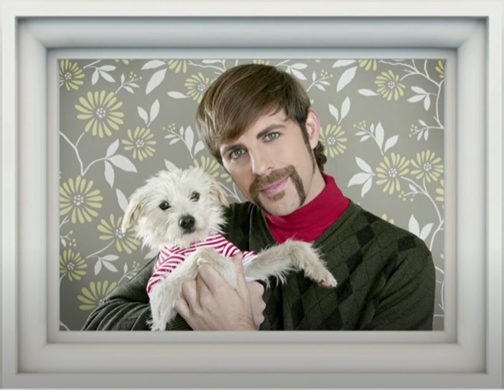




Slide 29
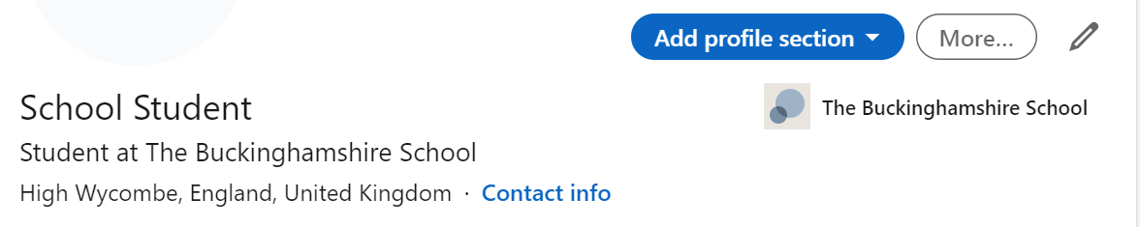
Build your profile strength: ‘Edit intro’
While we’re here, we’re going to make some further edits.
Click on the pencil to the right of ‘More’.

Slide 30

Build your profile strength: ‘Edit intro’
Now change the headline into a short, memorable professional slogan. Tell your new network what you are studying now or where you intend to go. Think about which keywords are useful for the industry you want to work in. For example:
“Student at [XXX School| Studying Biology, English & Geography”
“Sixth former preparing for career in healthcare”
“School student seeking work experience in physiotherapy”
“Year 13 applying for degree in environmental science”

Slide 31
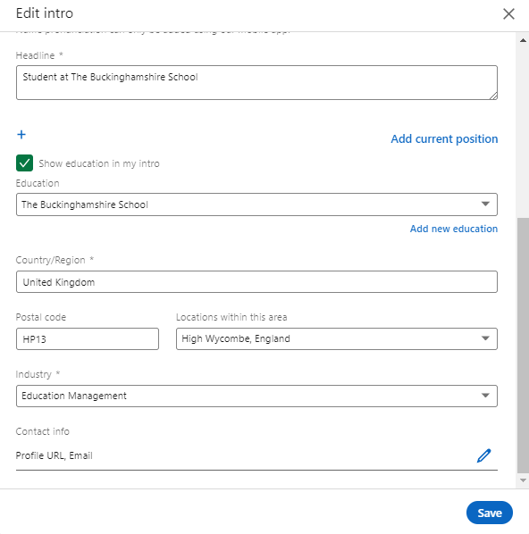
Build your profile strength: ‘Edit intro’
Check the box to show your education in your intro.
If it makes you insert an industry, either pick one you’re interested in going into or select ‘Education management’ which is the nearest to school for now.
Finally, edit your contact information. For now, just leave the email address you input at the start.
Click ‘profile url’ and then ‘Personalize the URL for your profile’ to take from you something like www.linkedin.com/in/john-smith-7a47101bb to www.linkedin.com/in/johnsmith - which is a neat link to feature on your cv.

Slide 32
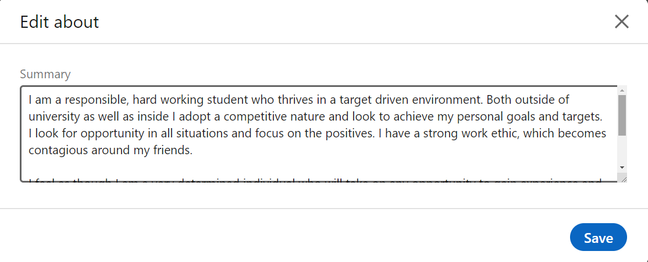
Build your profile strength: ‘About’
In the About section, add a summary which
is a short snapshot of who you are. Think of
it as your mission statement explaining what
your personal brand stands for.
Try answering these questions:
  What are your goals, aspirations, ideal job
  and current level of qualifications?
  How would you judge your own personal strengths and skills?
  Do you have a particular request eg Looking for work experience as a pharmacist?
  Have you done work experience, part-time jobs?
  What are your extra-curricular interests?

Slide 33
Build your profile strength: ‘About’ continued
Be concise and confident.
Let your personality shine though and aim to be remembered.
You have a 2,000-character limit, but you don’t have to reach this.
Break up the copy so that it is easy to read.
There is no spelling/grammar check in LinkedIn, so create it in
Word and copy across.

Slide 34
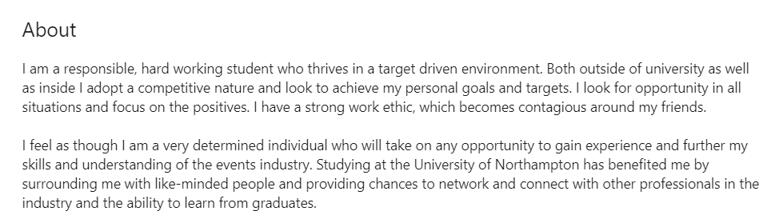
Build your profile strength: ‘About’ continued
Here’s a lovely example from a Buckinghamshire pupil who’s now at university. How would you adapt it to suit you? What would you say differently? How could you improve it further?

Slide 35
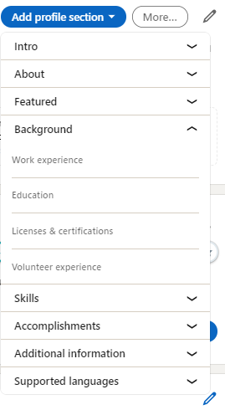
Build your profile strength: ‘Background’
Go back to the ‘Add profile section’ button and this time select ‘Featured’. Then work your way through. (Remember you can come back to each section and add or amend at any point.)
Add work experience: paid part-time jobs (babysitting, shop work?) and also non-paid work experience placements.
Add education: each time you complete the next level of your education, add it in here.
Add any licences and certifications: eg first aid certificate, Football Association Referees Course, National Pool Lifeguard Qualification?
Add volunteer experience: this always looks brilliant! If you don’t currently have any, make sure you get some.
Notes:
Presenters: please initiate a brief discussion about work experience placements and volunteering. Explain how these teach transferrable soft skills, how they help build up contacts and how they generally lay the foundation for a successful career. Ask students to share experiences and what they learned. If students feel like this section is a bit light, remind them it’s not too late – they should start working on news ones to add.

Slide 36
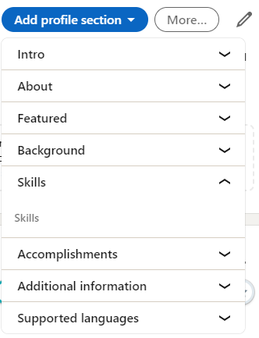
Build your profile strength: ‘Skills’
Add at least 5 skills (you can eventually add up to 50!) you feel
you possess. For example: communication, teamwork, creativity,
leadership, problem-solving, social media, Microsoft Word.
Choose keywords and core skills relevant to your future career.
Look at online job adverts as well as LinkedIn profiles of people
who have the kinds of roles you want.
Think back through your part-time work and work experience:
what skills have these taught you?
Do some research into what employers are looking for:
  www.prospects.ac.uk/careers-advice/applying-for-jobs/what-skills-do-employers-want
  www.indeed.com/career-advice/resumes-cover-letters/skills-employers-look-for

Slide 37
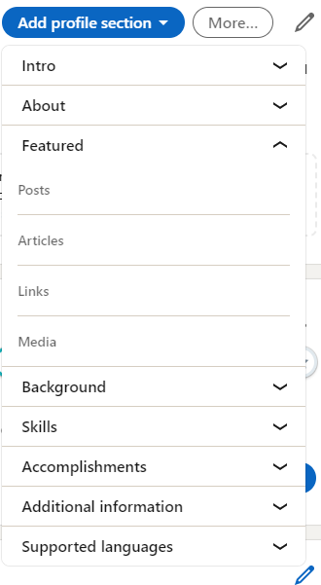
Build your profile strength: in your own time
Outside class in your own time, go back and look at these sections:
Featured: showcase things you’re particularly proud of using images, documents and web links. A feature you wrote for the school newsletter? A project you completed? A competition entry?
Accomplishments: add information throughout your career on
publications, awards, memberships of industry organisations.
Additional information: you can ask for recommendations here.
If you left a good impression, approach your work experience boss
or your part time job employer.
Supported languages: speak a second language? Add this to your profile in this to really impress!

Slide 38
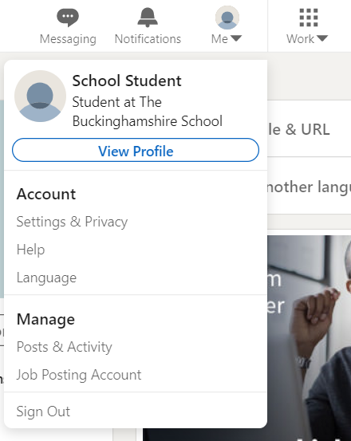
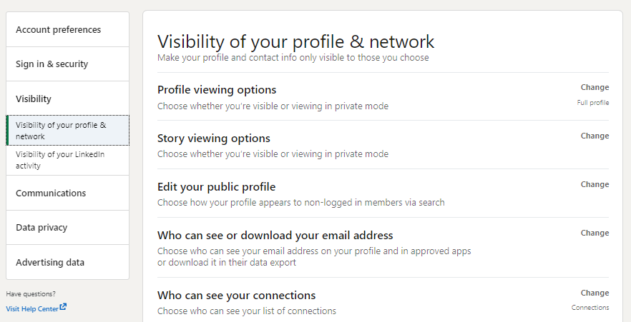
And finally: Settings & Privacy
Like with all social media, you should know where to see and change your settings & privacy and review these regularly.
In LinkedIn, these are found under ‘me’ on the
top right under ‘account’. This is where you
access, among other things, your profile
information, manage your account, look at sign
in & security and change advertising preferences.
Visibility is important: this is how you control
who sees your profile and network so please
do review this.

Slide 39
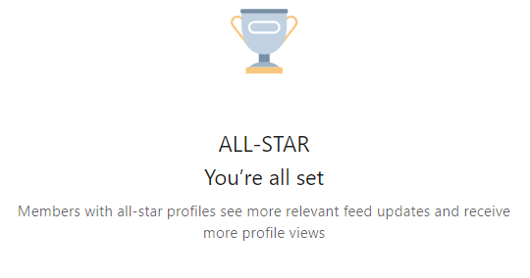
Congratulations: you’ve got an all-star profile!
And that’s your LinkedIn profile pretty much completed!
Remember: you don’t have to complete
all the sections to achieve an all-star
profile: LinkedIn will tell you when
you’ve done enough.
You can go back and change it at any
point: keep it up-to-date. You are
sometimes asked if you want to share
a section updated with your network
as you make changes: uncheck ‘Share
with network’ if you don’t want this.

Slide 40
Remember your profile highlights:
1) Education
2) Photo
3) Experience
4) Voluntary experience
5) Skills
Notes:
A quick summary to pull all the key areas out.

Slide 41
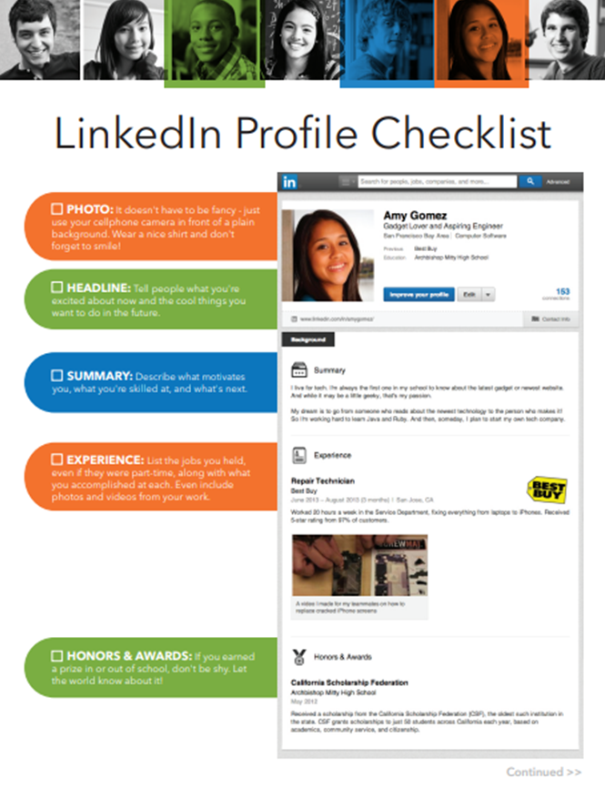
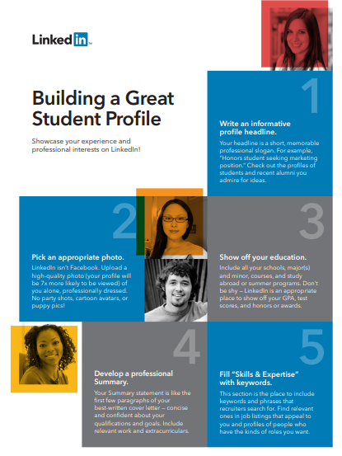
Need more help?
There’s a lot to take in! If you need more
help, LinkedIn provides two useful tip sheets:
Building a Great Student Profile:
download here
LinkedIn Profile Checklist (for secondary
school students): download here

Slide 42
Step 3: Link with connections
“Dear Alex, You really inspired me to look into engineering careers at your recent talk to Buckinghamshire School sixth formers. Could I please add you to my network?
Now it’s time to explore careers & contact people
who can help kickstart your career.
Make it meaningful: always connect with people you
actually know and be selective.
Start with friends, family, classmates, teachers, work
experience and volunteering mentors and employers.
Personalise each request instead of using the generic “I’d like to add you to my professional network on LinkedIn” message. Remind him/her where you met or explain why you want to connect. They’ll be more likely to respond.
”

Slide 43
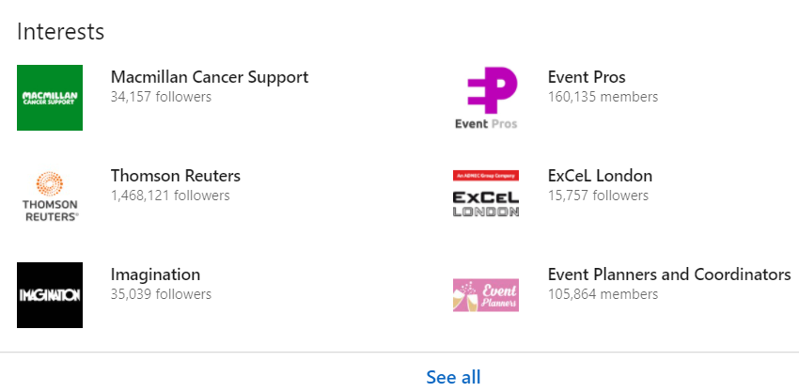
Then actively widen your reach:
Join groups: search and join LinkedIn Groups related to your interests, future career or industry trends.
Search for groups by name or keyword in the ‘Search’ bar at the top left of LinkedIn or browse for groups recommended for you clicking on ‘Work’ at the top right and selecting select ’Groups’ from the menu.
Groups you join appear at the bottom of your profile, showing that you want to engage in professional communities.

Slide 44
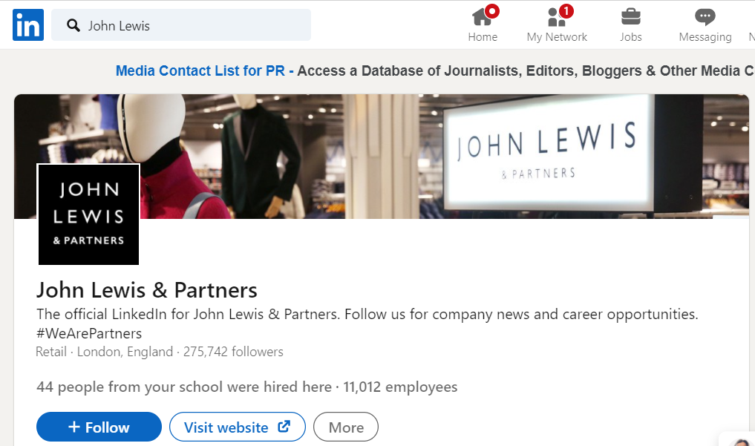
Then actively widen your reach:
Follow companies: follow companies you’re interested in. Become an expert by staying on top of the latest news and be in the know on employers you want to work for.
Simply input a company name into the search bar at the top left corner of LinkedIn. Find what you are looking for and then click ‘follow’.

Slide 45

Then actively widen your reach:
Follow influencers: learn from leaders you admire and
build insider knowledge.
Each year LinkedIn publishes its Top Voices of the year
in different industry sectors. It’s your chance to meet
the professionals driving today’s business conversation.
2020’s list ranges from Dr. Noel Yeo, a physician in
Singapore documenting his experiences fighting
COVID-19 on the frontlines to Adrienne Tom, a career
coach in Canada, sharing resources for job seekers looking
to land their next position in a challenging job market.
Visit www.linkedin.com/pulse/linkedin-top-voices-2020-meet-professionals-driving-todays-roth/

Slide 46

Got a job interview coming up? Check out your interviewer’s profile, company page and prep for questions.
Looking for work experience opportunities? Who could you approach to ask?
You now have the perfect tool at your fingertips!

Slide 47
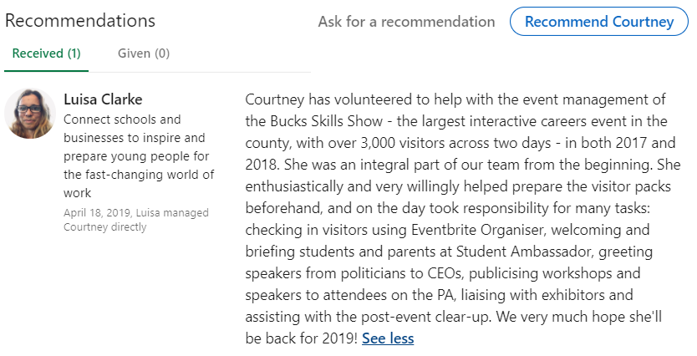
Ask your contacts for recommendations
If you’ve been offered an interview, chances are the company has already checked out your LinkedIn profile – and recommendations always look impressive.
Ask people who’ve directly managed or mentored you for a recommendation to help you stand out from the crowd.
Repay the favour if you’ve enjoyed working with someone.

Slide 48
Step 4: Share content
Stay visible: update your status regularly. Sharing content helps you stay on your network’s radar and build your professional image. Mention your projects, professional books or articles (and your opinions on them) or events you’re attending. Many recruiters read your feed!
Be authentic: communicate on LinkedIn the same way you would in professional interactions outside of LinkedIn. No need to be overly formal or change your style – be real, be you, but be professional. Always proofread everything!
Give more than you take. As well as updating your own status and asking for help or connections, comment on other people’s updates and help with their requests. Be generous. Keep your contacts warm.

Slide 49

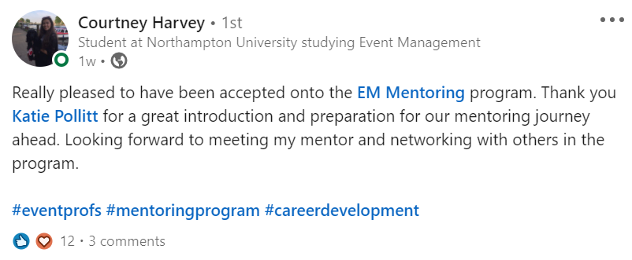
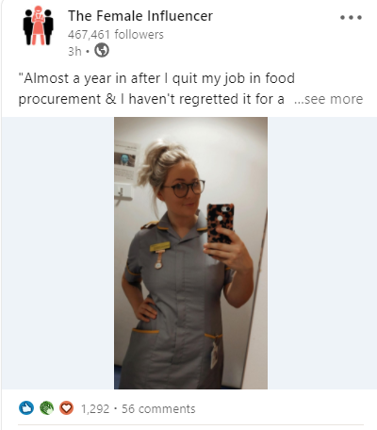
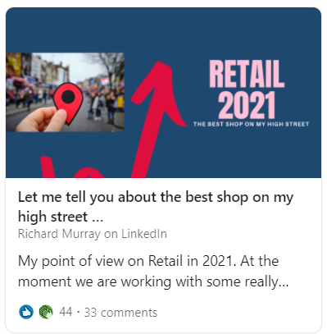

Slide 50
Hungry for more?
Go to www.university.linkedin.com/linkedin-for-students for videos, checklists and tip sheets including:
Get hired video series
The student job hunting handbook
Build your professional brand
Building a student profile
Finding a job or internship
Networking on LinkedIn
Networking on LinkedIn
Tailoring your LinkedIn profile to your goals
Communicating on LinkedIn
Building your personal professional brand

Slide 51
Donut time – and feedback
How have you got on? Is anyone brave enough to share their profile?
Would anyone like individual feedback?

