Slide 1

The Buckinghamshire job market
Presenter XYZ Name
Role/Business/School/College
http://www.bucksskillshub.org/

Slide 2
Careers and Enterprise Company (D of E)
Priorities:
Raise Quality
Drive experience with Employers
Boost skills pathways
Tackle disadvantage
Connect careers to economic need
How does that affect you?
Biggest influencers on your child’s decision making
Employer interaction is key
More support for those who need it
Understanding the Bucks economy

Slide 3

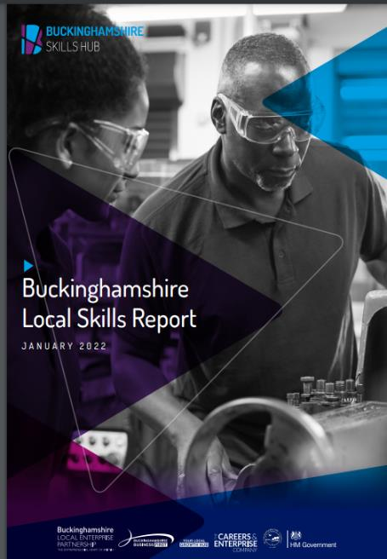
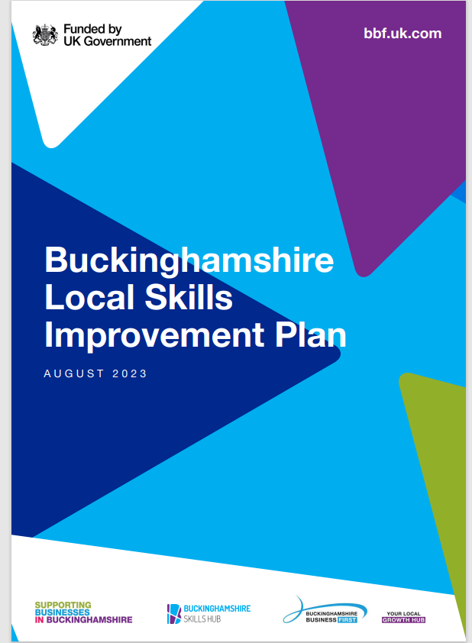
Local Skills Improvement Plan - Buckinghamshire Business First (bbf.uk.com)
www.bucksskillshub.org

Slide 4
The five sectors in Buckinghamshire that employ the most people are…
Health & social care
Hospitality
Education
Finance & insurance
Manufacturing
Construction
Admin & support services
IT / digital
Public administration
Transport & storage
Agriculture
Property
Energy & water
Creative
Wholesale & retail
Professional, scientific & technical

Slide 5
































Some large local employers…

Slide 6









And some smaller ones (with big ambitions!)

Slide 7
The priority sectors in Buckinghamshire…
Cross-sector priorities
Construction
Digital
Engineering
Film & TV
Health & Social Care (including Life Sciences)
Work Readiness
Leadership & Management
Digital and AI Literacy
Green Skills
Notes:
Employability skills, teamwork, communication, problem solving, literacy, numeracy, creativity & self management;

Slide 8
The national Skills England priority sectors projected to expand and create quality jobs are…
Creative industries
Digital and technologies
Construction
Clean energy
Health & Social Care
Professional and business services
Life sciences
Financial services
Defence
Advanced manufacturing
Notes:
Employability skills, teamwork, communication, problem solving, literacy, numeracy, creativity & self management;

Slide 9

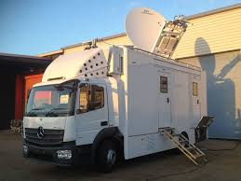
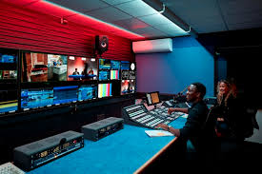
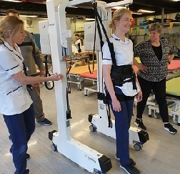
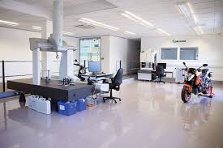



Areas of the economy our County specialises in…
From space propulsion, broadcasting, high-end TV and film and spinal injuries…
… to precision engineering, manufacture of measuring instruments, digital technology and wholesale of pharmaceutical and computing products.

Slide 10
Common Skills Issues in Bucks:
Skills mismatch: Between skills sought by employers and those held by residents.
Attracting talent: Challenges due to high housing costs, lack of vibrancy in urban centres, poor public transport to rural areas.
Retaining talent: High proportion of skilled residents leave for university or move out for better jobs.
Small businesses: 42% of employees work for companies with fewer than 50 people (32% nationally).
Recruitment difficulties: 18% of employers had hard-to-fill vacancies (15% nationally).
Skills shortage vacancies: over a third of vacancies are due to skills shortages.
Staff proficiency: 13% of employers had staff not fully proficient (national average 15%).
Training issues: 30% of employers with a skills gap cited lack of appropriate training; 58% funded or arranged training (national average of 60%).

Slide 11


FILM & TV
UK Film and TV sector is booming – ‘film and high-end TV production spend in the UK was £6.8 billion in 2025, a 22% increase on 2024’s first reported figures’ (Source: BFI, 2026)
There are nearly twice as many creative industry jobs per head in Bucks than the national average.
Pinewood Studios, the home of the British film industry; the James Bond and Star Wars franchises; and Disney’s UK base, is located within Buckinghamshire.
The National Film and Television School in Beaconsfield is one of the top film schools in the world.
Other local companies include CTV Outside Broadcasts and Naked West: think Strictly Blackpool and royal weddings; The Apprentice and Grand Designs.

Slide 12


FILM & TV
Pinewood Studios:
For over 85 years, Pinewood Studios have been making films, enabling storytellers to bring their creations to life on big & small screens. (Taskmaster, Ru Paul’s Drag Race)
Home to classics including James Bond, Star Wars and the Marvel Cinematic Universe. (23 of the 25 007 films)
Pinewood Studios in south Bucks is home to the legendary 007 Stage, 23 stages, 3 dedicated state of the art TV studios, the unique permanently-filled Underwater Stage, acres of backlot production space plus post-production and lighting services.
It has plans approved to grow further over the next few years and will create thousands of new jobs.
Visit www.pinewoodgroup.com/

Slide 13
FILM & TV
Fastest growing occupations by employment (2019-2024)
Actors, Entertainers and Presenters
Top occupations by online vacancies (2024)
Graphic and Multimedia Designers
Musicians
Arts Officers, Producers and Directors
Authors, Writers and Translators
Arts Officers, Producers and Directors
Photographers, Audio-visual and Broadcasting Equipment Operators
Skills shortages and gaps
Virtual Production & VFX Adaptable and transferable skills: communication, teamwork, flexibility.
Technical skills: ability to work with new software, Artificial Intelligence, and sustainable production practices
GCSE / A Level Options
Film studies: English language or literature, Art and design, IT and computing, Media studies / Film studies, Photography
More information is available at: UCAS
Digital Media production and technology: Art, Design technology, Computing, Engineering, Graphic design, Photography

Slide 14
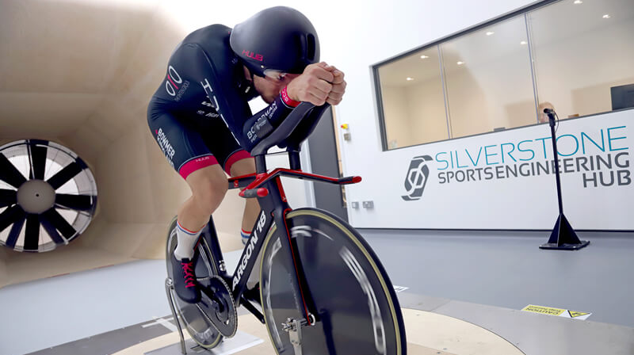
High Performance Engineering
From electric cars, 3D printing and sports engineering companies based at Silverstone Technology Park near Buckingham (opposite the Silverstone Formula 1 racing circuit) to world-famous aircraft ejection seat manufacturer Martin-Baker in the south of the county, Buckinghamshire is home to ground-breaking high-tech engineering companies.
Jobs within the sector include:
Product developer
Programme manager
Software engineer
Geotechnical engineer
Mechanical / electrical engineer
New property developments at Silverstone Park and Westcott Venture Park are attracting new high-tech businesses and are creating new jobs.

Slide 15


Engineering: Martin-Baker ejection seats
Visit https://martin-baker.com
Martin-Baker is the world leader in the design and manufacture of ejection and crashworthy seats. A family-run business, it has saved over 7,600 lives.
Martin-Baker says: “We believe in helping individuals grow... We are looking for talented and dedicated people that are interested in making a real difference.”
Jobs range from admin support to IT network engineer, calibration inspector to equipment maintenance technician.
Find out about its apprenticeship programme at https://martin-baker.com/careers/apprenticeships/

Slide 16

Engineering: Westcott Space Cluster
Space is one of the UK’s fastest growing sectors.
Westcott Space Cluster, near Aylesbury, is home to a growing number of space related-companies, developing new technologies include rocket propulsion, 5G comms & autonomous (‘smart’) systems like drones.
Big developments are planned on the Westcott site over next 10 years. In 2025, £5.9m in grant funding was awarded for a 62,000 sq. ft development, including training facilities, communal space and shared technical facilities available for space industry and academia to rent, plus a lecture theatre, classrooms, a workshop and space for industry to rent.
There are currently skills shortages for technicians and propulsion test specialists within the space sector. Studying STEM subjects at school is the best starting point for a career in the space sector.

Slide 17

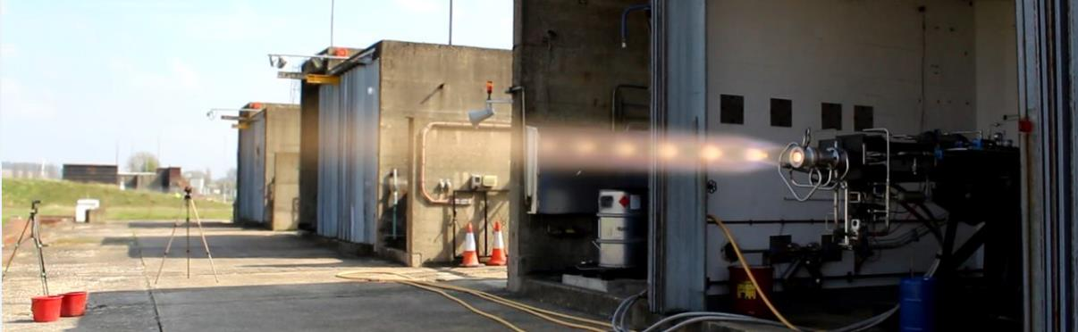
Engineering: Nammo, Westcott
Visit www.nammo.com/location/westcott/
Nammo Westcott supplies chemical propulsion to spacecraft manufacturers.
Rocket engines and thrusters are bought by commercial, defence and science markets.
In 2016 it was a Nammo Westcott engine that provided the insertion burn to allow NASA’s JUNO spacecraft to successfully enter into orbit around Jupiter.
Their Westcott employees work on development, production and testing.

Slide 18
High Performance Engineering
Fastest growing occupations by employment (2019-2024)
Top occupations by vacancies (2024)
Skills shortages and gaps
Digital Skills & Automation - working alongside robots and computer-controlled machinery
Specialised engineering and installer skills – work experience is particularly important
GCSE / A Level Options
Aerospace engineer: Physics, Maths, IT or computing, Design technology
Engineering and Technology: Maths, Physics, Computing, Product Design
More information is available at: UCAS
Vehicle Technicians, Mechanics and Electricians
Mechanical Engineers
Engineering Technicians
Production and Process Engineers
Telecoms and Related Network Installers and Repairers
Engineering Professionals - wide range of occupations in civil engineering, research & development, and science
Assemblers (Vehicles and Metal Goods)
Electrical and Electronics Technicians
Metal Machining Setters and Setter-operators
Production and Process Engineers
Notes:
Fastest growing occupations by employment (2019-2024)
Engineering Professionals - wide range of occupations in civil engineering, research & development, and science (+62 jobs)
Assemblers (Vehicles and Metal Goods) (+31 jobs)
Electrical and Electronics Technicians (+27 jobs)
Metal Machining Setters and Setter-operators (+20 jobs)
Production and Process Engineers (+20 jobs)
Top occupations by vacancies (2024)
Vehicle Technicians, Mechanics and Electricians (417 vacancies in 2024 in Bucks)
Mechanical Engineers (415 vacancies in 2024 in Bucks)
Engineering Technicians (378 vacancies in 2024 in Bucks)
Production and Process Engineers (282 vacancies in 2024 in Bucks)
Telecoms and Related Network Installers and Repairers (257 vacancies in 2024 in Bucks)
Skills shortages and gaps
Digital Skills & Automation - working alongside robots and computer-controlled machinery
Specialised engineering and installer skills – work experience is particularly important
GCSE / A Level Options
Aerospace engineer: Physics, Maths, IT or computing, Design technology
Engineering and Technology: Maths, Physics, Computing, Product Design
More information is available at: UCAS

Slide 19

Construction
Major infrastructure projects are underway in Buckinghamshire – HS2, East West Rail etc.
95,000 new homes required by 2045 in Buckinghamshire (according to the draft local plan for Buckinghamshire)
Opportunities to make existing homes greener and help tackle climate change: insulation installers, heat pump installers, retrofit assessors etc.

Slide 20
Construction
Fastest growing occupations by employment (2019-2024)
Roofers, Roof Tilers and Slaters
Top occupations by vacancies (2024)
Skills shortages and gaps
Shortages across various occupations, particularly experienced trades people, machinery operators, and civil engineering roles
GCSE / A Level Options
Maths, Physics, Design technology, Geography
More information is available at: UCAS
Health and safety skills increasingly in demand.
Glaziers, Window Fabricators and Fitters
Bricklayers
Quantity Surveyors
Elementary Construction Occupations (Groundworkers)
Construction and Building Trades (specialised)
Electricians and Electrical Fitters
Carpenters and Joiners
Notes:
Fastest growing occupations by employment (2019-2024)
Roofers, Roof Tilers and Slaters (+94 jobs)
Glaziers, Window Fabricators and Fitters (+75 jobs)
Bricklayers (+22 jobs)
Top occupations by vacancies (2024)
Quantity Surveyors (282 vacancies in Bucks in 2024)
Elementary Construction Occupations (Groundworkers) (259 vacancies in Bucks in 2024)
Construction and Building Trades (specialised) (231 vacancies in Bucks in 2024)
Electricians and Electrical Fitters (186 vacancies in Bucks in 2024)
Skills shortages and gaps
Shortages across various occupations, particularly experienced trades people, machinery operators, and civil engineering roles
Health and safety skills increasingly in demand.
GCSE / A Level Options
Maths, Physics, Design technology, Geography
More information is available at: UCAS

Slide 21

Digital
The digital sector has a significant influence in Bucks – the share of people employed in the sector in Bucks is some 20% higher than the national average.
Skills shortages exist across various occupations owing to new technology & the pace of change – AI and software development skills are particularly in demand
Relevant for virtually all employers in Buckinghamshire!

Slide 22
Digital
Fastest growing occupations by employment (2019-2024)
Computer System and Equipment Installers and Servicers (including installing computer equipment in drones, robots, etc.)
Top occupations by vacancies (2024)
Programmers and Software Development Professionals
Skills shortages and gaps
Artificial Intelligence skills – both for developers and users
Cybersecurity – stricter requirements on digital security require more people with cybersecurity skills
GCSE / A Level Options
Computing and IT, Physics, Maths, Design technology
Art and Media studies – useful for digital marketing roles
More information is available at: UCAS
IT User Support Technicians
Science, Engineering and Production Technicians (i.e.: applications of digital technology in engineering, manufacturing, and science)
Data Analysts
IT Business Analysts, Architects and Systems Designers
IT User Support Technicians
IT Network Professionals
Science, Engineering and Production Technicians
Customer service and business skills – ability to support users and think about commercial applications of software
Notes:
Fastest growing occupations by employment (2019-2024)
Computer System and Equipment Installers and Servicers (+270 jobs!)
IT User Support Technicians (+99 jobs)
Science, Engineering and Production Technicians
Data Analysts (+7 jobs)
Top occupations by vacancies (2024)
Programmers and Software Development Professionals (770 job vacancies in 2024)
IT Business Analysts, Architects and Systems Designers (243 job vacancies in 2024)
IT User Support Technicians (227 job vacancies in 2024)
IT Network Professionals (159 job vacancies in 2024)
Science, Engineering and Production Technicians (140 job vacancies in 2024)
Skills shortages and gaps
Artificial Intelligence skills – both for developers and users
Customer service and business skills – ability to support users and think about commercial applications of software
Cybersecurity – stricter requirements on digital security require more people with cybersecurity skills
GCSE / A Level Options
Computing and IT, Physics, Maths, Design technology
Art and Media studies – useful for digital marketing roles
More information is available at: UCAS

Slide 23
Health & Social Care
The largest employer in the county & the UK! With over 350 different careers, and adding 1,350 jobs from 2019-2024.
BUT with acute recruitment and retention difficulties.
Good provision for clinical roles, the sector needs to attract more people into jobs in non-clinical roles.
It needs to upskill the existing workforce especially in digital skills.

Slide 24
Health & Social Care
Fastest growing occupations by employment (2019-2024)
Nursing Assistants / Healthcare Assistants
Top occupations by vacancies (2024)
Care Workers and Home Carers
Skills shortages and gaps
Only 39% adult social care workers in Buckinghamshire have a relevant qualification (Skills for Care, 2025)
Reported lack of digital skills to support admin tasks across healthcare jobs – ICT GCSEs are increasingly important for this sector
GCSE / A Level Options
English, Psychology, Sociology, Biology, Chemistry, Health and Social Care
PE – useful for work in physical rehabilitation
More information is available at: UCAS
Registered Nursing Professionals
Physiotherapists
Registered Nursing Professionals
Social Workers
Health Care Practice Managers
Health Associate Professionals (specialised therapists, such as radiographers, surgical assistants etc.)
Notes:
Fastest growing occupations by employment (2019-2024)
Nursing Assistants / Healthcare Assistants (+428 jobs)
Registered Nursing Professionals (+307 jobs, higher if specialised registered nursing roles are included)
Physiotherapists (+109 jobs since 2019)
Health Services and Public Health Managers and Directors (+92 jobs since 2019)
Occupational Therapists (+89 jobs since 2019)
Top occupations by vacancies (2024)
Care Workers and Home Carers (1456 job vacancies in 2024)
Registered Nursing Professionals (715 job vacancies in 2024, but higher if other specialised nursing roles are included, such as midwifery, community nurses etc.)
Social Workers (509 job vacancies in 2024)
Health Care Practice Managers (473 job vacancies in 2024)
Health Associate Professionals (specialised therapists, such as radiographers, pediatrics etc.) - (382 job vacancies in 2024)
Skills shortages and gaps
Only 39% adult social care workers in Buckinghamshire have a relevant qualification (Skills for Care, 2025)
Reported lack of digital skills to support admin tasks across healthcare jobs – ICT GCSEs are increasingly important for this sector
GCSE / A Level Options
English, Psychology, Sociology, Biology, Chemistry, Health and Social Care
PE – useful for work in physical rehabilitation
More information is available at: UCAS

Slide 25
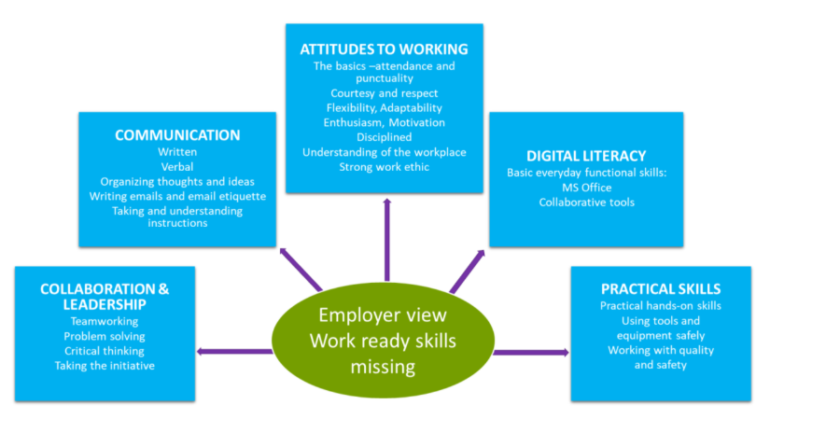
Work-readiness model from employer feedback:

Slide 26


Slide 27

Find out more on our website:
A one-stop shop for all skills and career-related advice in Buckinghamshire. www.bucksskillshub.org
Thank you. Any questions?

